Slide 1
Monogame and Basic Game Theory
Chris Sippel

Slide 2
Agenda
Basic game theory
What is MonoGame
Let's make a game
How to make a game for multiple platforms
Bite sized examples
Questions

Slide 3
Disclosure
This is a very simple, game making tutorial. Making a game can be very complex and difficult. If you are serious about making games, I would suggest finding more comprehensive tutorials online.
The libraries I have made and will show you are meant for a very simple game. They weren't designed to work with anything other than a very simple 2D birds eye view walking game. Remember, there is no framework or library that handles all situations.

Slide 4
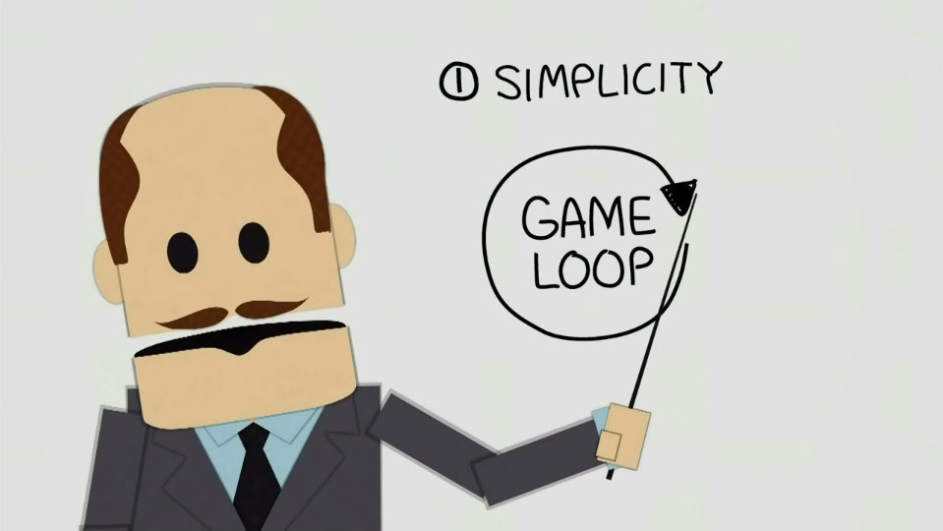
Basic Game Theory - The Game Loop
At the absolute base of all games, is the all might Game Loop

Slide 5
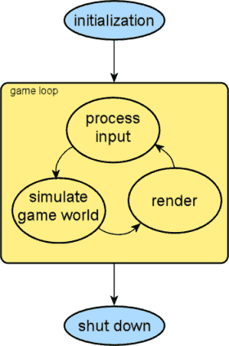
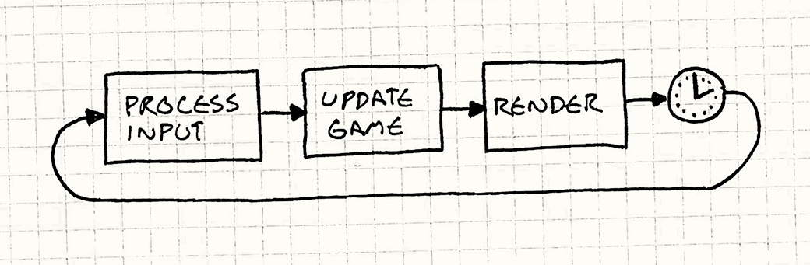
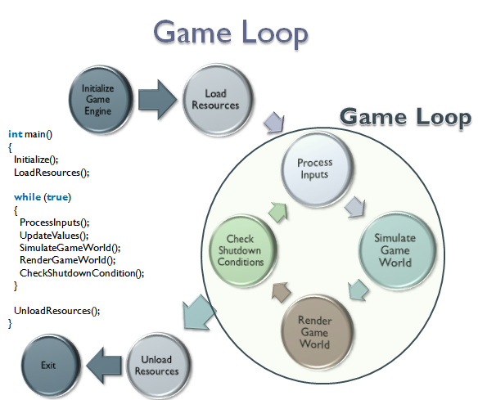
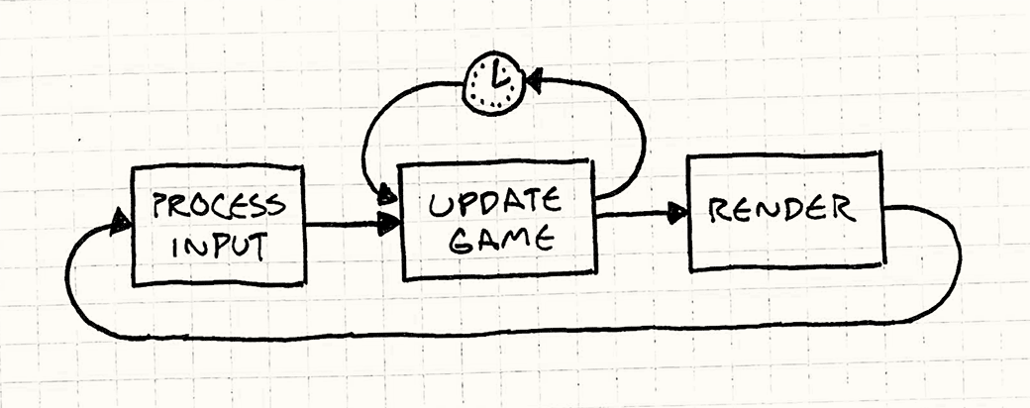
Each game loop is different

Slide 6


But, each game loop has the same three processes: Process input, Update the world, Draw all the things!

Slide 7
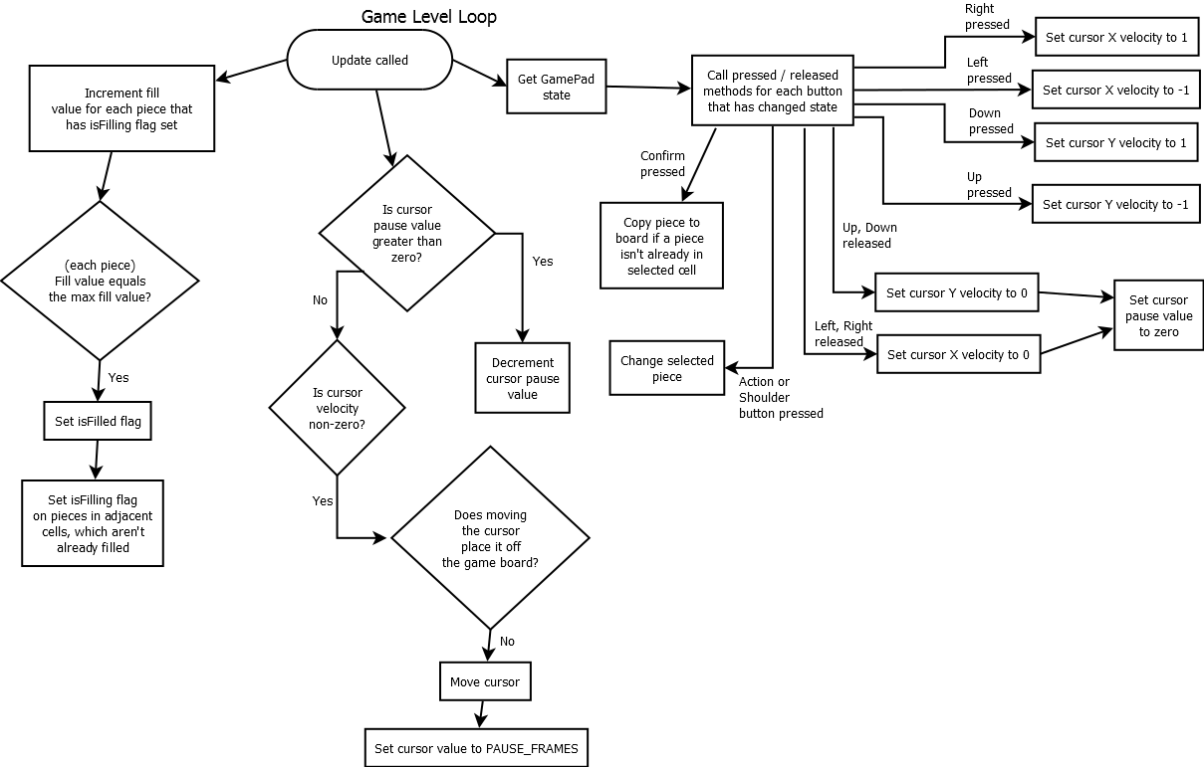
Game loops can become really complicated, think of MMOs for example. For this presentation we'll keep it simple and talk to specifically as to how MonoGame does its game loop.

Slide 8

MonoGame what is it?
MonoGame is a framework that makes creating cross-platform games in C# rather simple

Slide 9
Why would I want to use MonoGame
There's definitely a some benefits to using MonoGame
It's in C#
It's cross platform
iOS
Android
Mac
Linux
Windows, Windows Phone
Playstation 4
It's open source
It has a large community
It's proven
It's a great place to start learning how to make games
Notes:
Over 1000 games have been written using MonoGame. Some of the more popular indie games have been written using MonoGame: TowerFall, Bastion, Fez, Skulls of the Shogun, Square Heroes

Slide 10
Enough with the talk, let's make a game
Software used
MonoGame 3.4 http://www.monogame.net/2015/04/29/monogame-3-4/
Visual Stusio 2015 Community Edition https://www.visualstudio.com/en-us/downloads/download-visual-studio-vs.aspx
VMware Workstation http://www.vmware.com/ca/en/products/workstation
Ubuntu 14.04.3 LTS http://www.ubuntu.com/download/desktop
MonoDevelop on Ubuntu http://packages.ubuntu.com/search?keywords=monodevelop

Slide 11
How to design your code base
To reduce the amount of code duplication you should place your code in libraries. How you split up your libraries is up to you. For my example, I've split them up like so
Animation
Character
Ui
Allows for the animation of 2D sprites
Allows for the controlling of a user's character
Contains a very basic button

Slide 12

When making libraries, you need to use the NuGet package MonoGame.Framework.Portable. Yes, it is pre-release, but it gets the job done.
You can use BOTH a portable library, or a standard library when making a new library, but pick one type, and only use that one type exclusively. Unfortunately, you need to use .NET 4.0!! I spent WAY too long trying to figure this out.

Slide 13
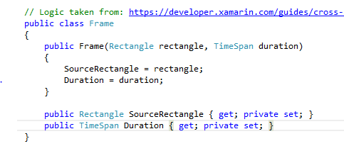
MonoAnimation
Frame.cs
Represents a single frame in an animation, and how long that frame should last in the animation

Slide 14
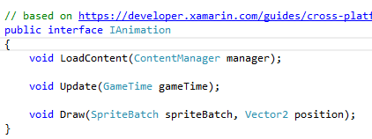
IAnimation.cs
The interface that defines the methods needed by an animation

Slide 15
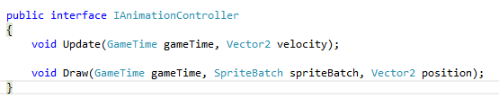
IAnimationController.cs
The interface that defines the methods needed by an animation controller

Slide 16
BirdsEyeViewWalkingAnimationController.cs
An animation controller that animated 4 way walking and standing in a birds eye view

Slide 17
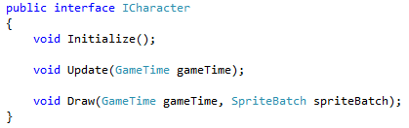
MonoCharacter
ICharacter.cs
Defines the methods a character must implement
It would have been better to make an implementation of ICharacter, but I would need MonoAnimation and they are different libraries types, which means I can't reference MonoAnimation in MonoCharacter

Slide 18
KeyboardControlledPlayableCharacter.cs
An ICharacter that keeps track and updates the character's properties

Slide 19
MonoUi
Ibutton.cs
Defines the methods and properties that a button must implement

Slide 20
BasicButton.cs
A very basic button using rectangles

Slide 21

To use events, or not to use events

Slide 22

Off! To the world of Linux

Slide 23
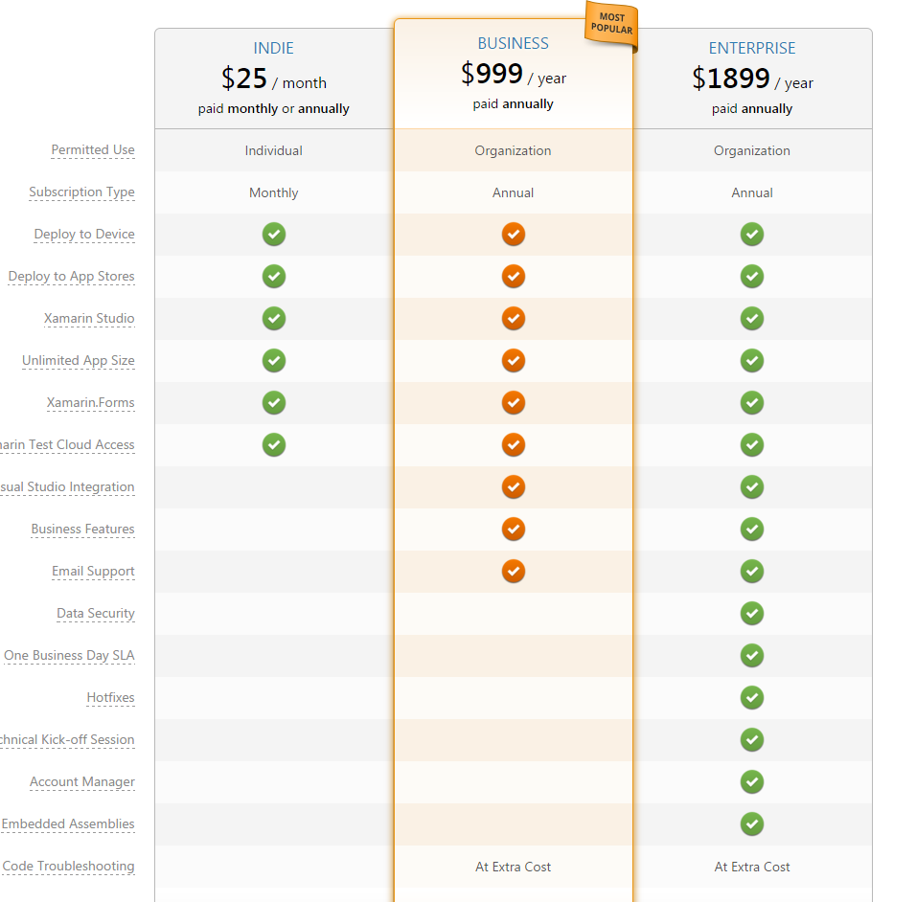
What about the other platforms
That's the interesting bit about MonoGame. If making either an Android or iOS app, you need to use Xamarin.

Slide 24
Things to remember
Decide what platform(s) you game will run on
Figure out each of the variables that apply to that platform
what screen resolutions do you have to deal with
what is the physical size of the device
what input devices can there be
What kind of drawing mechanism does the platform use OpenGL, DirectX

Slide 25



@Chris_Sippel
Chris_Sippel@Hotmail.com

